Slide 1

Understanding Aircraft Accident Severity: Aircraft Type, Damage Category, and Time (2018–2022)
By: Chris Mau Karagu

Slide 2
Business Understanding
Why this analysis matters:
Company expanding into aviation operations
Need: safe, cost-aware fleet acquisition
Primary stakeholder: Executive Leadership / Head of Aviation Division
Business problem: identify types associated with lower severity outcomes
Notes:
The business context is fleet acquisition. Leadership wants evidence-based guidance on which aircraft types appear safer to operate. Since we’re using accident records, we focus on severity outcomes as a way to inform shortlisting and risk-screening rules.

Slide 3
Objective and Success Criteria
Objective: compare severity across aircraft types using historical accident records
Deliverables:
ranked severity metrics by aircraft type
damage-category severity patterns
time trend summary (2018–2022)
3 acquisition-ready recommendations
Document assumptions & limitations
Notes:
This is a decision-support project. Success means producing clear severity metrics, highlighting the strongest severity signals, showing whether severity is changing over time, and translating the findings into recommendations leadership can act on.

Slide 4
Research Questions
RQ1: Which aircraft types show the lowest severity?
fatal accident rate; avg fatalities/accident
RQ2: How does severity differ by damage category (and by type)?
RQ3: How does fatal accident rate change over time (2018–2022)?

Slide 5
Data Understanding
Rows: 2,500; Columns: 8
Fields: acc.date, type, reg, operator, fat, location, dmg
Key quality issues:
acc.date stored as text
fat stored as text
Notes:
The dataset includes accident records with aircraft type, date, fatalities, and a damage code. Two important cleaning are necessary: dates and fatalities are stored as text, so they must be parsed before analysis.

Slide 6
Data Quality
Missing rates:
reg 3.68%
operator 0.56%
fat 0.48% (50 records)
Approach:
keep records, but use correct denominators for rate calculations
Notes:
Missingness is low overall, but fatalities are sensitive; treating unknown fatalities as zero would bias fatal rates downward. So missing fatalities are kept in the dataset but excluded from fatal-rate denominators.

Slide 7
Data Preparation
Dropped Unnamed: 0 (exported index)
Renamed acc.date → acc_date
Parsed acc_date to datetime; created year
6 invalid dates → excluded from year-based analysis only
Converted fat to numeric
Created flags:
fat_missing, is_fatal_known, is_fatal_strict = fat > 0
Notes:
This step made the data analysis-ready: removed non-analytical columns, created reliable time features, converted fatalities to numeric, and created explicit flags so fatal-rate calculations use the correct denominator.

Slide 8
Data Preparation (Damage Category Standardization)
Mapped dmg to dmg_cat:
non → No damage
min → Minor damage
sub → Substantial damage
w/o → Written off
unk → Unknown
mis → Missing
Distribution:
Substantial: 1330
Written off: 702
No damage: 338
Minor: 98
Unknown: 30
Missing: 2
Notes:
The damage field is originally encoded. I mapped it into human-readable categories so results can be interpreted and communicated. The distribution also tells us the dataset is dominated by substantial damage and written-off cases.

Slide 9
Findings (RQ1: Lowest-severity types under threshold)
Lowest fatal accident rate (n ≥ 20 accidents/type)
Aircraft types with 0% fatal accident rate in this dataset (n ≥ 20):
Airbus A320-214
Airbus A320-232
Boeing 737-8AS (WL)
Threshold improves fairness and stability of comparisons
Notes:
Under the minimum sample rule, these three aircraft types show a zero percent fatal accident rate within the dataset. The key point is that the threshold prevents a type with only a few accidents from appearing artificially “best.”

Slide 10
Findings (RQ2: Damage category drives severity)
Written off accidents:
Fatal accident rate: 52.23%
Avg fatalities/accident: 6.64
Much higher than other damage categories
Interpretation: catastrophic damage outcomes strongly align with fatal severity
Notes:
“Written off” stands out as more than half are fatal and the average fatalities are high. For acquisition and operations, this supports focusing on controls that reduce catastrophic-loss outcomes, not just total accident counts.

Slide 11
Findings (RQ3: Time trend 2018–2022)
Annual fatal accident rate range: 14.62%–17.45%
Year-to-year variability is present
No consistent upward or downward pattern (2018–2022)
Notes:
The time analysis shows variability, but no steady trend in severity during the five-year period.

Slide 12
Executive Summary (Decision-Relevant Takeaways)
Shortlist signal: three common types show 0% fatal rate (with n ≥ 20)
Strongest severity driver: damage category, especially Written off
Time: variability exists, but no consistent trend (2018–2022)
Best use: severity-based screening, not prediction

Slide 13
Recommendations
Recommendation 1: Build a purchase shortlist using a minimum-evidence rule
Only evaluate aircraft types with ≥ 20 accidents (stability threshold)
Prioritize types with the lowest fatal accident rate and lowest avg fatalities/accident
Recommendation 2: Shortlist signal from this dataset (2018–2022, n≥20)
Airbus A320-214, Airbus A320-232, Boeing 737-8AS (WL) → 0% fatal accident rate
Treat as candidates.
Recommendation 3: Add a “catastrophic outcome” screen using damage category
Because Written off aligns with extreme severity (52.23% fatal, 6.64 avg fatalities)
Procurement and operations should prioritize aircraft and operating profiles that reduce pathways to Written off outcomes

Slide 14
Limitations
No exposure data (e.g., flight hours/cycles) : cannot estimate true risk rates; results support screening, not definitive safety rankings
Selection/reporting bias: dataset includes accidents, not all operations; comparisons may be influenced by reporting completeness and operating context
Missing/invalid fields:
50 missing fatalities excluded from fatal-rate denominators (to avoid treating unknown as zero)
6 unparseable dates excluded from year-trend analyses

Slide 15
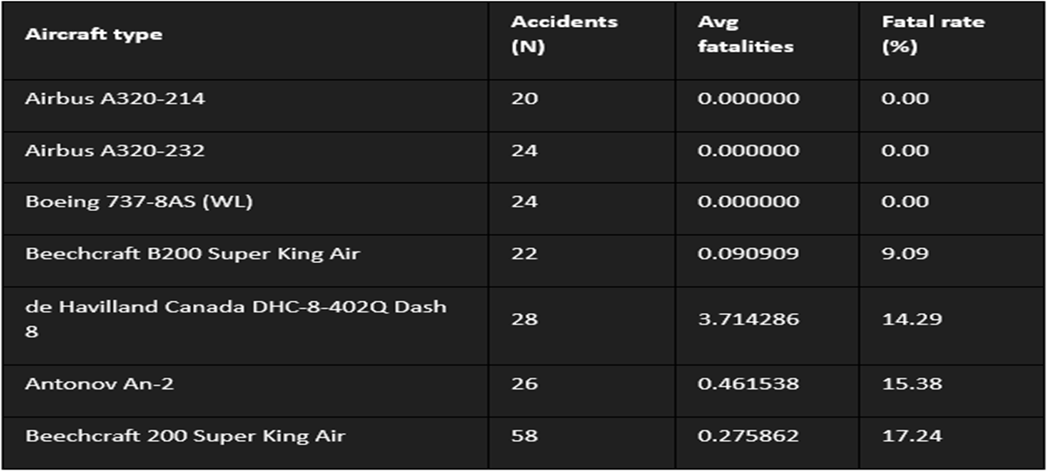
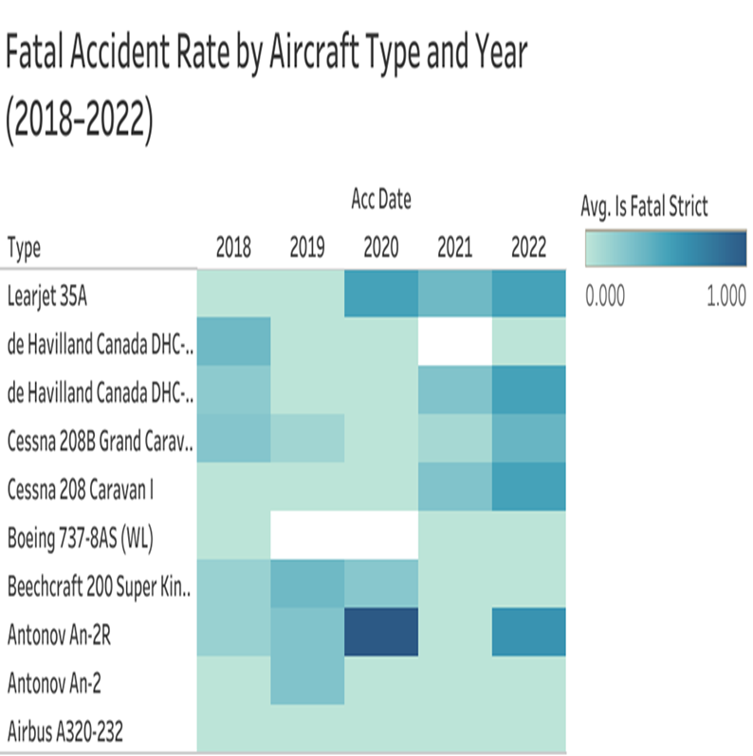
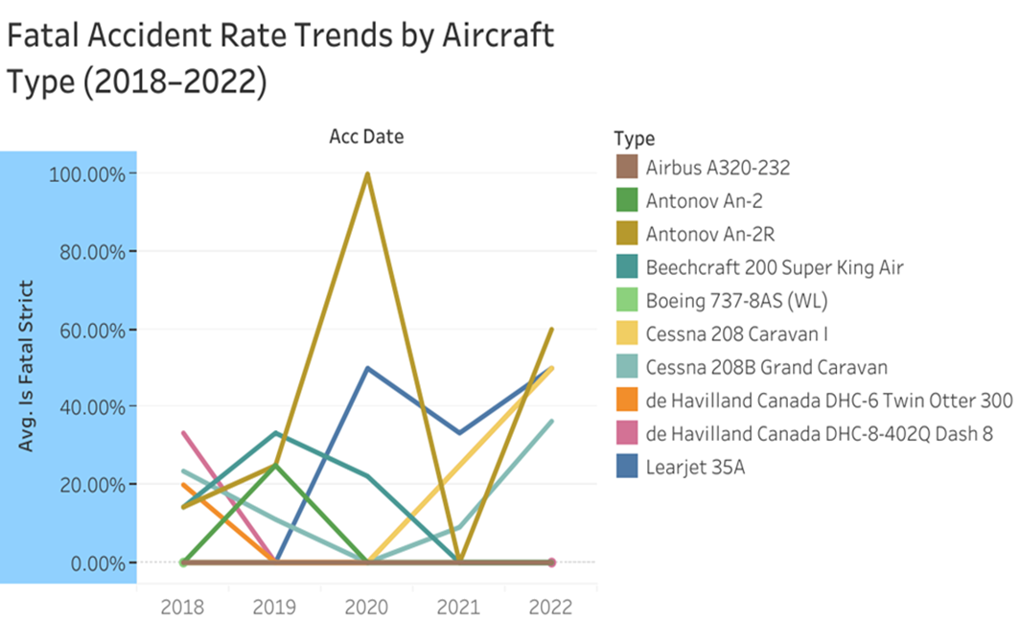
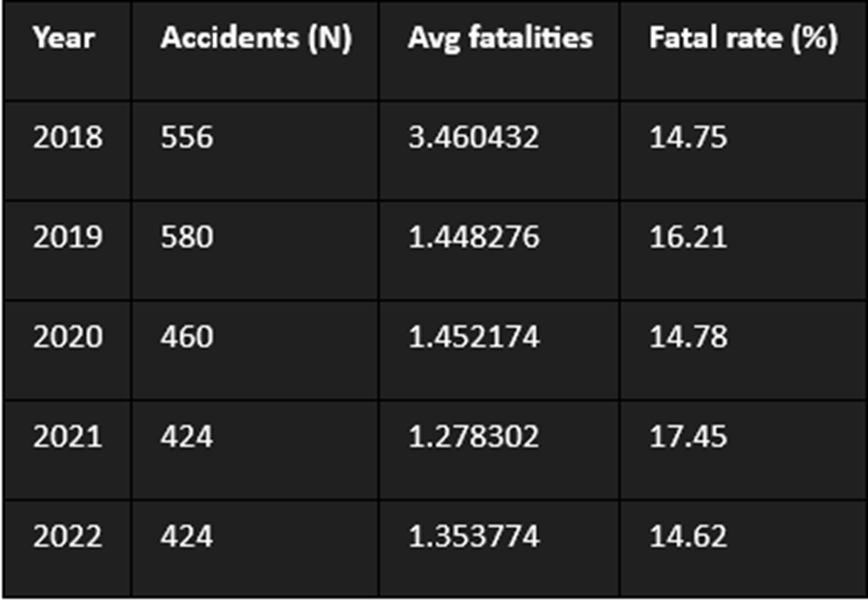
Appendix (Tables and Graphs Used)

